Slide 1


ARTIFICIAL
INTELLIGENCE
Applications and its Future
A.I.
Big Data
Images
Videos
IoT
Audios
Texts
Dr. Jia-Wei Chang
jwchang@nutc.edu.tw
jiaweichang@mail.ncku.edu.tw

Slide 2
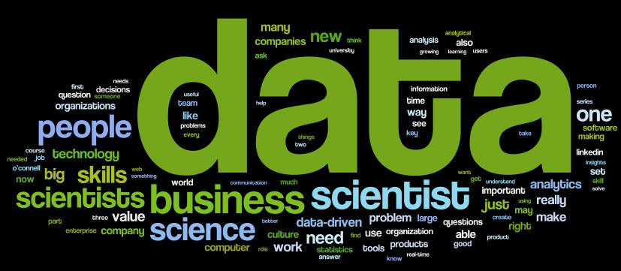
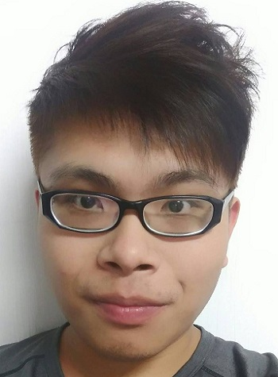
About Me
[Since Jan. 2019] Young Professionals Chair, IET Taipei Local Network.
[Since Dec. 2017] Consultant, NEXCOM Industry 4.0 Center.
[Jan. 2017] Ph.D. degree, National Cheng Kung University.
Work Experience
2018/8 ~ Now
Assistant Professor
National Taichung University of
Science and Technology
2018/2 ~ Now
Adjunct Assistant Professor
National Cheng Kung University
2015/8 ~ 2017/11
Project Manager & Data Scientist
NEXCOM International Co., Ltd.
Research Topics
Natural Language Processing
Natural Language Understanding
Chatbot
Text Summarization / Classification
Deep Learning
Data Mining
Internet of Things
Smart Speaker

Slide 3
History
Past to Future
Natural Language Processing Lab, National Taichung University of Science and Technology

Slide 4
A.I. History
1950-1960
1990-Now
2020-Future
Symbolicism
Machine Learning
What’s Next?
Where is Intelligence?
Thinking & Logic
Data
Perceptron,
1957-1962
SVM,
1995
Backpropagation & Convolution,
1980s
1980-1990
2006-Now
Expert Systems
AlphaGo, 2016
Deep Learning
Domain Knowledge
Data & Features
Natural Language Processing Lab, National Taichung University of Science and Technology

Slide 5
Keywords
Data to Intelligence
Natural Language Processing Lab, National Taichung University of Science and Technology

Slide 6
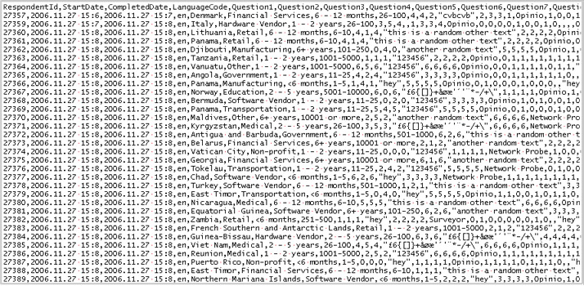
Data?
Natural Language Processing Lab, National Taichung University of Science and Technology

Slide 7
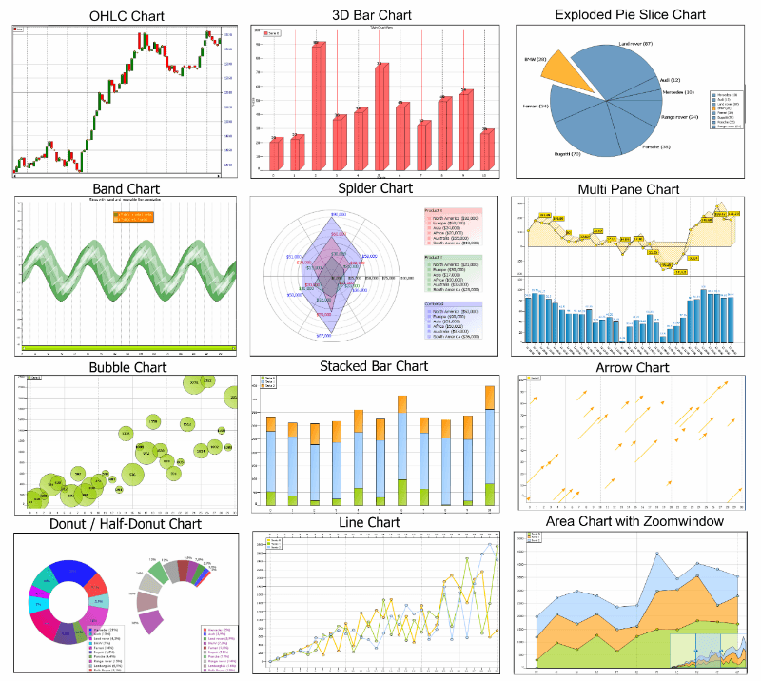
Information?
Natural Language Processing Lab, National Taichung University of Science and Technology

Slide 8




Keywords
Intelligence
Decision Making, Reasoning
Analysis, Judgement
Creativity, Thinking
Data
Information
Knowledge
Intelligence
Knowledge
Integration of Information, Experience, and Cultures
Specific Domain
High Expertise
Information
Data with preprocessing
Meaningful / Useful Clues
Data
Raw Records
Meaningless
Lack of organization or classification
Natural Language Processing Lab, National Taichung University of Science and Technology

Slide 9
Types
Natural Language Processing Lab, National Taichung University of Science and Technology

Slide 10
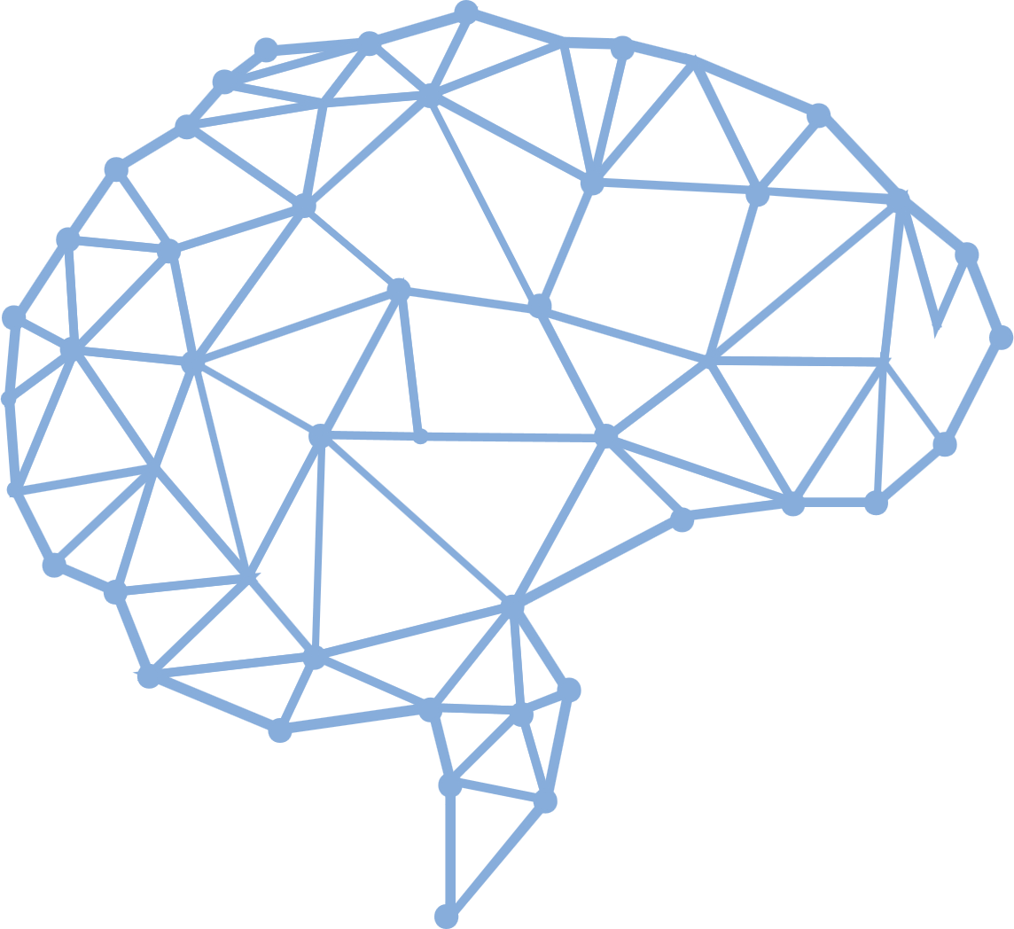
Types of A.I.
Strong A.I.
Make it smart likes a human beings.
Strong A.I. is expected to do anything that human can do. It is an AI-complete or AI-hard problem.
Weak A.I.
Make it to solve a specific problem.
For example, Chatbot or Object Detection.
Natural Language Processing Lab, National Taichung University of Science and Technology

Slide 11

IBM Watson
Natural Language Processing Lab, National Taichung University of Science and Technology

Slide 12
The Most Famous A.I. - AlphaGo
Natural Language Processing Lab, National Taichung University of Science and Technology

Slide 13



The Most A.I. We Can See
Natural Language Processing Lab, National Taichung University of Science and Technology

Slide 14
Applications
A.I. Everywhere
Natural Language Processing Lab, National Taichung University of Science and Technology

Slide 15
A.I. Can Appear Everywhere
Social network applications
Marketing applications
Robots
Factories
Financial industry
Medicals
Chatbot
Car driving
Search engines
Natural Language Processing Lab, National Taichung University of Science and Technology

Slide 16



SEARCH ENGINES
Natural Language Processing Lab, National Taichung University of Science and Technology

Slide 17


MARKETING APPLICATIONS
Natural Language Processing Lab, National Taichung University of Science and Technology

Slide 18



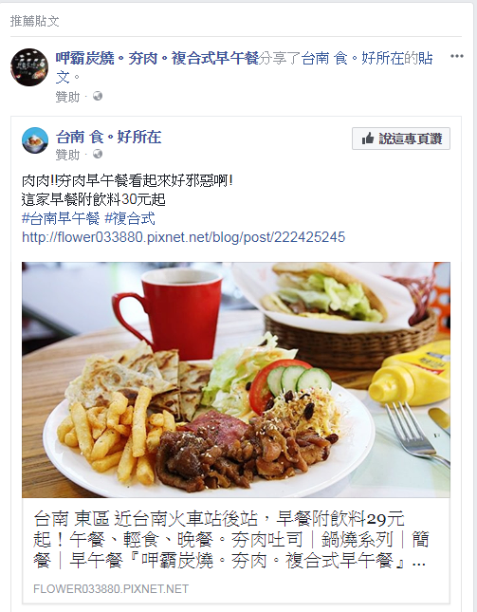
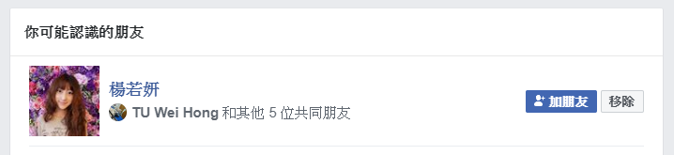



SOCIAL NETWORK APPLICATIONS
Natural Language Processing Lab, National Taichung University of Science and Technology

Slide 19
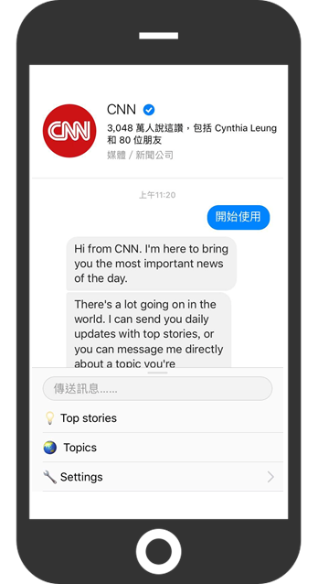
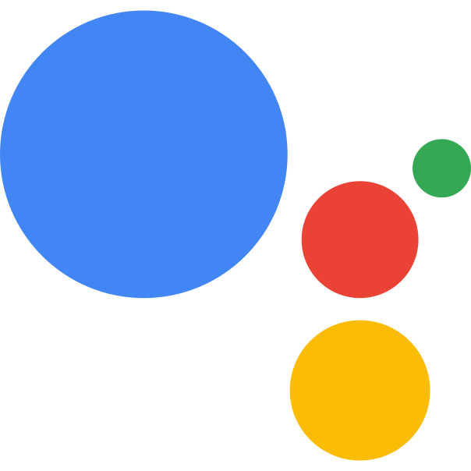

CHATBOT
Siri
Google Assistant
Natural Language Processing Lab, National Taichung University of Science and Technology

Slide 20

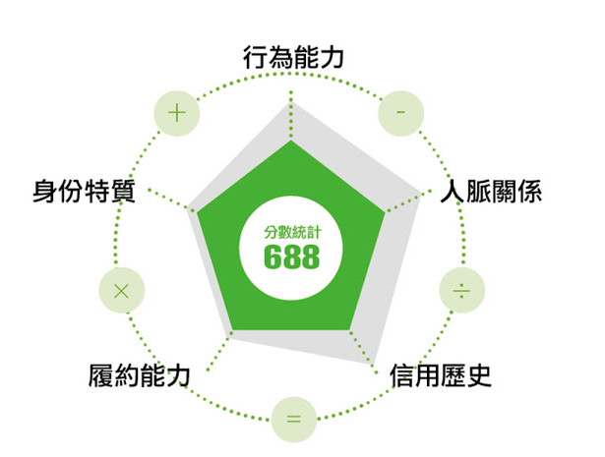
FINANCIAL INDUSTRY
Natural Language Processing Lab, National Taichung University of Science and Technology

Slide 21
AI FOR MEDICAL
醫療影像
Google、IBM、
騰訊、阿里、Intel
醫院管理
Qventus、CloudMedx
醫學研究
IBM、Microsoft、Hanover
輔助診療
IBM、百度
AI
醫療
健康管理
碳雲智能、 Validic、Evolent Health
藥物開發
IBM、BenevolentAI、Insilico Medicine
精準醫療
華大基因、Flatiron、Deep Genomics
虛擬助理
Microsoft、科大訊飛、Sense.ly
Natural Language Processing Lab, National Taichung University of Science and Technology

Slide 22
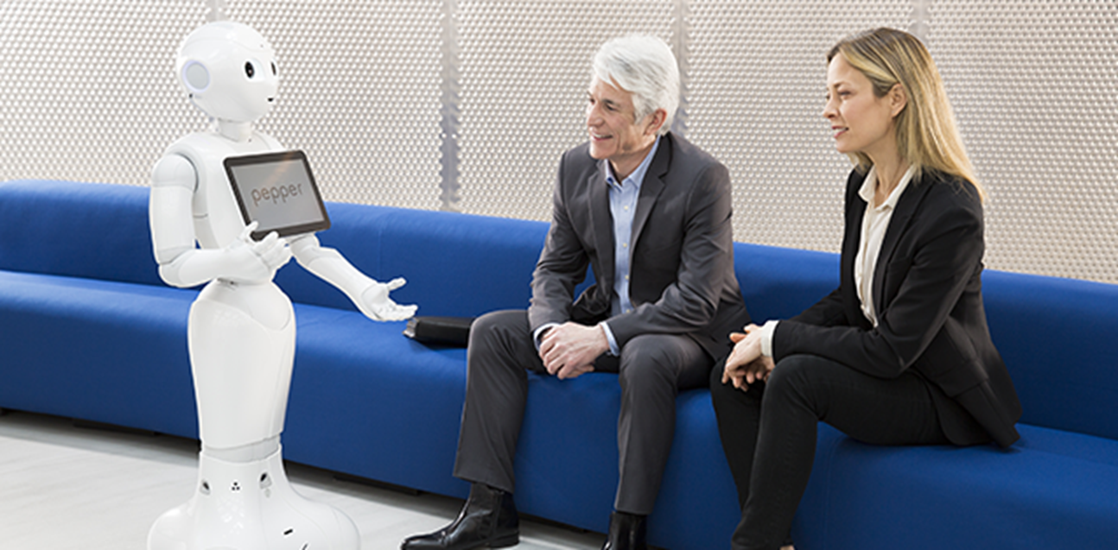
ROBOTS
Natural Language Processing Lab, National Taichung University of Science and Technology

Slide 23
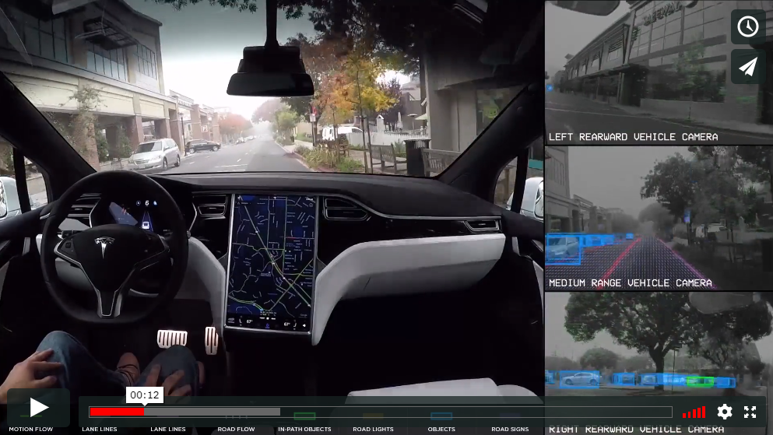
CAR DRIVINGS - Autopilot
Natural Language Processing Lab, National Taichung University of Science and Technology

Slide 24
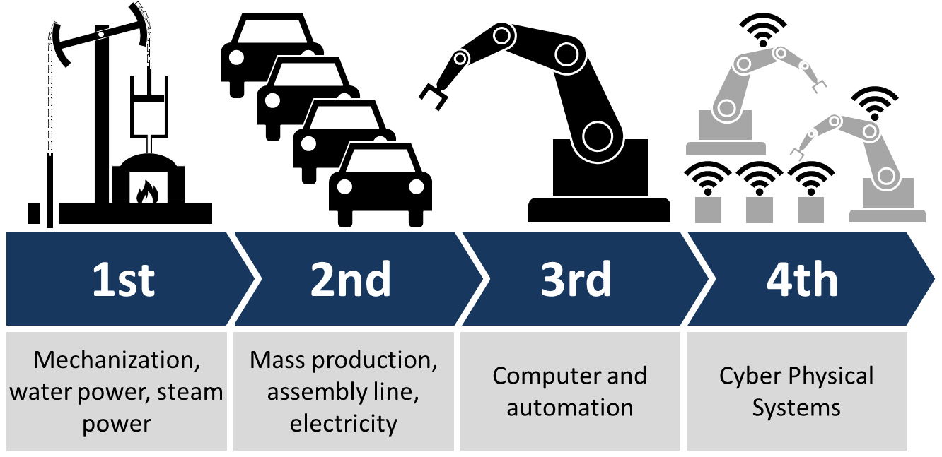
Industry 4.0
Natural Language Processing Lab, National Taichung University of Science and Technology

Slide 25
Methodolgy
Natural Language Processing Lab, National Taichung University of Science and Technology

Slide 26
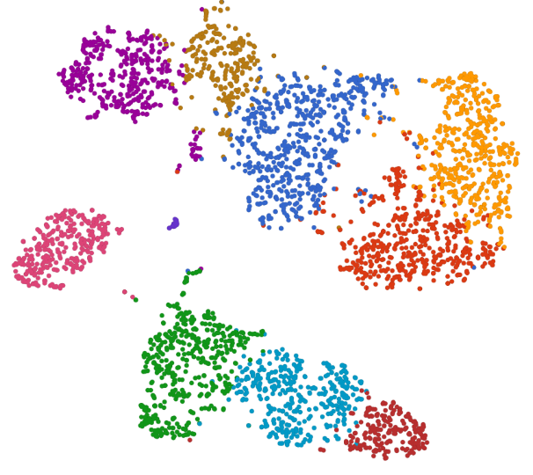


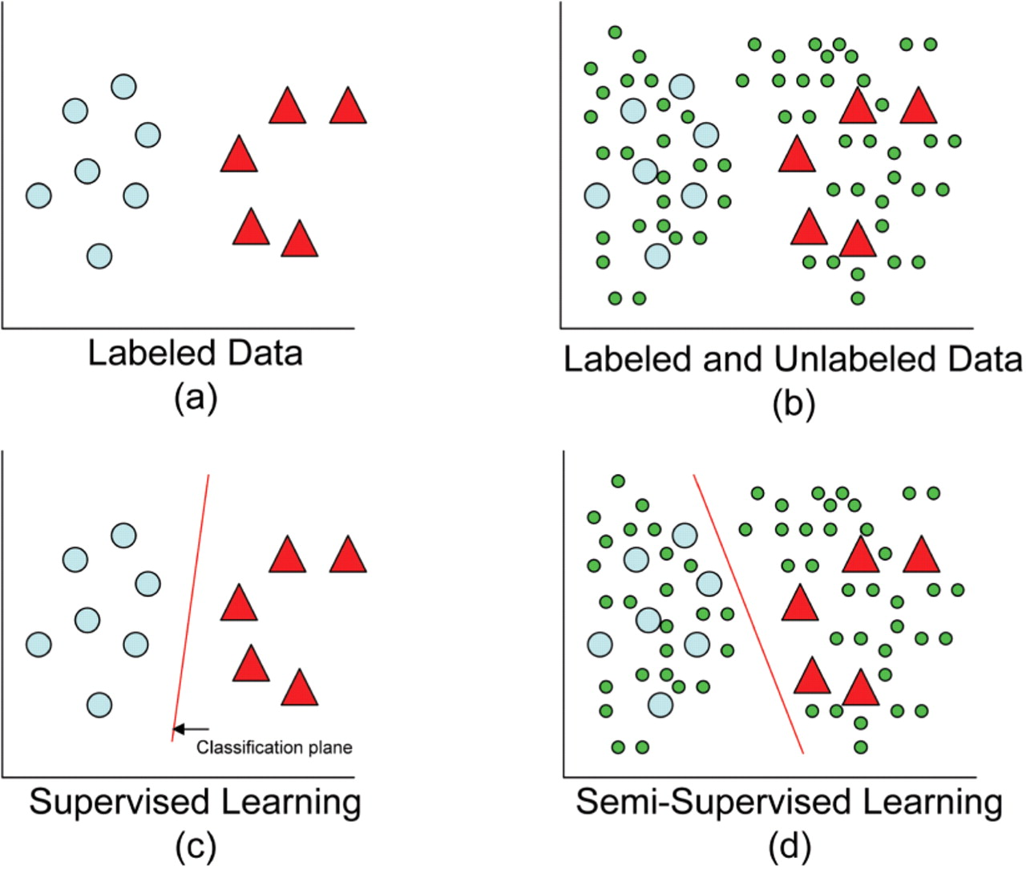


A.I. Methodology
Unsupervised Learning
Semi-supervised Learning
Discover the similarities between data.
Make the similar ones to be a group. Separate unsimilar groups as possible.
First train a supervised learning model, and then retrain the model to improve its robustness by unlabeled data.
Supervised Learning
Reinforcement Learning
Classify data into multiple categories.
Learn the identification rules from data and its labels.
First set reasonable rewards of game rules to the RL model, and then train the model via trial and error.

